Slide 1



X
Promo Effectiveness Review
Reporting Engineer
Presented by
Agis Fauzi Rachman

Slide 2


Agis Fauzi Rachman
Insert Your Experience
Reporting Engineer Virtual Internship
Jubelio | April 2023
Profile
Data Scientist Virtual Internship
IDX Partners | February 2023
Agis is a taxation graduate who has an interest in data analysis with 4 months of training and 3 months of virtual internship experience assigned to analysis data and create visualizations with PostgreSQL, Python and Microsoft Excel.
Big Data Analytics Virtual Internship
PT Kimia Farma | January 2023

Slide 3
Case Study
Every 6 months (End of Semester) Omnichannel Jubelio conducts
Promo Effectiveness Review, to see the effectiveness of PROMO CODE
to the total sales of one marketplace.
As a reporting engineer there are several tasks that you need to do.
1. Apply Promo Code from the Budgeting Team.
2. Create the 3rd and 4th Quarter Special Report Table.
3. Perform Summary and Visualization of the Results of the 3rd Quarter Table Data
and 4.
4. Create a Special Shipping Label for the month of December.

Slide 4
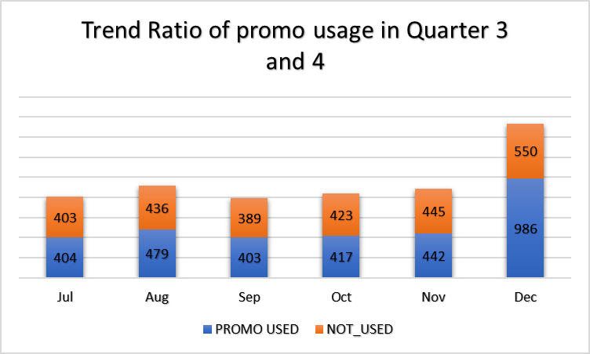
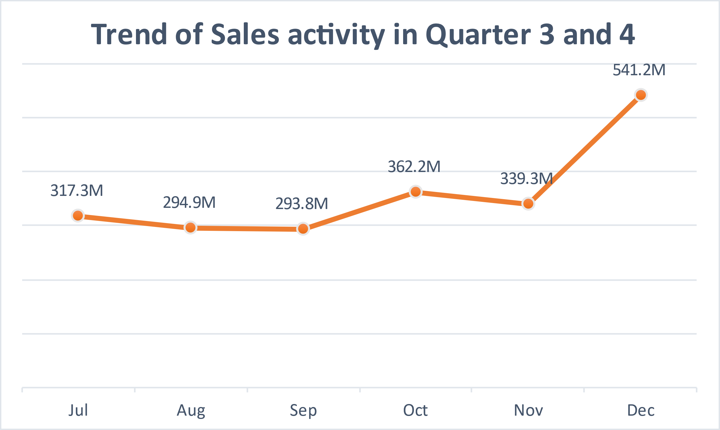
Result
The end of the year is the month with the most sales and the perfect time to give a promo.

Slide 5
Link Github
agisrachman/Promo-Effectiveness-Review (github.com)

Slide 6
Video Presentation
Task5_Agis Fauzi Rachman - Google Drive

Slide 7
Thank You
X

